Slide 1
Montana Child Care
Business Connect
What is Cost-Informed Rate Setting?
Thursday, February 23, 2023
Part 5 of 7 in the Tiny Training Series
This project is funded in whole or in part under a Contract with the Montana Department of Public Health and Human Services. The statements herein do not necessarily reflect the opinion of the Department.

Slide 2
What is:
The 'Tiny Training Series’
Statement of Purpose
2023 Schedule
Series of seven, 30-minute webinars
The 2nd and 4th Thursdays at 1:30pm
Attendance of four equals 2 hours of ECP credits
Define basic business concepts
Feature Business Connect Partners
February 23: What is Cost-Informed Rate Setting?
February 27: Precision Pricing for Family (2hrs)
March 6: Policies and Practices for Centers (2hrs)
March 9: What is Risk Management?
March 15: Board Governance for Programs (2hrs)
March 23: What are Different Types of Marketing?

Slide 3
What is:
Launched in:
2022
Supporting communities and entrepreneurs with business elements of starting, owning and operating childcare programs. We are Montana statewide hub for childcare business development and innovation
Focusing on:
Critical Areas:
Training, Technical Assistance, Mentorship, Community Capacity Building, Web-Resource Hub
Staffed by:
Rhonda Schwenke, Jason Nitschke, Heide Borgonovo, Shelby Whelan, Alex DuBois, Jennifer Owen, Program Assistant

Slide 4
Jason Nitschke; MA, EDFP
Education
2002 – M.A. Communications – Hawaii Pacific University
1997 – B.A. Journalism/Political Science – University of Montana
Economic Development & Entrepreneurship
2019-2022 – Vice President – Great Falls Development Authority
2014-2022 – Regional Director – Great Falls area Small Business Development Center (SBDC)
2011-2012 -- Carondelet Estate Services, LLC; St. Louis, MO
2000-2002 -- JNitschke Photography; Denver, CO
Certifications
2021 – Certified PeerSpectives Facilitator – Edward Lowe Foundation
2017 – Certified Export Counselor – U.S. Small Business Administration
2017 – Certified Profit Mastery Facilitator – Business Resource Services
2015 -- Economic Development Finance Prof. (EDFP) – National Development Council
2015 -- Accredited Small Business Consultant (ASBC) – Association of Accredited Small Business Consultants
2015 -- Certified Business Advisor – GrowthWheel International
Recognitions
2022 – Boots to Business National Instructor of the Year – U.S. Small Business Administration
2018 – Montana SBDC State Star
2010 – Television News Enterprise Award – Montana Broadcasters Association
2009 – Television Sports Reporting Award – Society of Professional Journalists
2007 – Television Sports Enterprise Award – Montana Broadcasters Association
Senior Child Care Business Advisor
"Helping entrepreneurs turn
visions into reality"

Slide 5
Goals for Today
I. Pricing Methodologies
II. Components of Costs
III. Calculating Cost-Informed Rates

Slide 6
But First…

Slide 7
And Also This…
Learn the Language of Financial Literacy
Understand Pricing Accuracy
Set Rates that Cover 100% of Your Future Costs

Slide 8
And…
Interchangeable Terms
Costs=Expenses
Price=Rates, Tuition, Fees, Etc
Revenue=Sales

Slide 9
Why is Pricing/Rate Accuracy Important?
A business is:
The process of selling a product/service in effort to make a profit.
Why do businesses fail?
If cash flow is insufficient:
A business is not viable.
If a business is not viable:
It cannot survive.
If a business closes:
Its customers must find services elsewhere.
If childcare businesses close:
The entire workforce and economy is impacted.

Slide 10
Introduction Question
How do you currently determine what to charge families?
I charge what Best Beginnings reimburses.
I charge what other providers charge.
I pull a number out of thin air.
I guess-timate what I think families can afford.

Slide 11
Introduction Question
The Correct Answer is…
I charge what Best Beginnings reimburses.
I charge what other providers charge.
I pull a number out of thin air.
I guess-timate what I think families can afford.
None of the Above & All of the Above

Slide 12
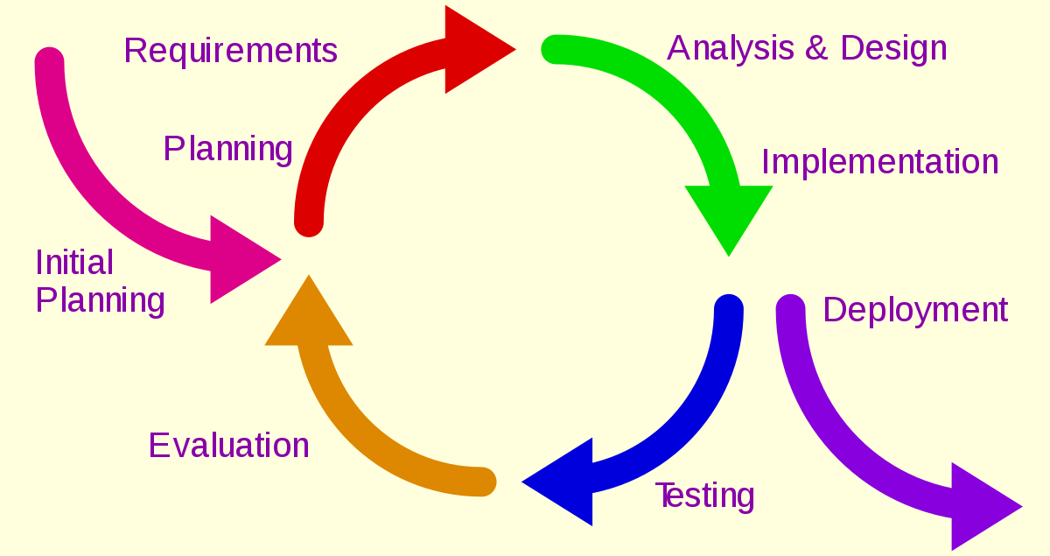
I. Pricing Methodologies
There are three specific approaches to calculating what to charge.
Competition-Based
Market-Based
Cost-Based
Iterative Process

Slide 13
I. Competition-Based Pricing
Definition: This is what direct competitors, in your immediate vicinity, charge for the exact same types of services.
Of note, there are two sub-categories:
Penetration pricing – intentionally setting prices low in order to attract initial customers.
Skimming pricing – intentionally setting a high initial price then offering discounts to appear as if a customer is getting a deal.
This Photo by Unknown Author is licensed under CC BY-SA

Slide 14
I. Market-Based Pricing
Definition: This is charging what customers in your immediate market can afford to pay.
Of note, there are a few concepts worth highlighting:
Premium pricing – intentionally suggesting your services are the best in the market.
Value pricing – considers the perceived benefits delivered to the customer on convenience or reputation.
Psychological pricing – plays into a customer’s wants and needs.

Slide 15
I. Cost-Based or Cost-Plus Pricing
Definition: This is setting prices based on your business’ actual or potential operating expenses, plus compensation to the owner and payment of profit to the company.
Pricing accuracy is dependent on knowing 100% of your operating expenses.

Slide 16
I. Pricing Methodologies
Art
and
Science
This Photo by Unknown Author is licensed under CC BY-SA
This Photo by Unknown Author is licensed under CC BY-SA-NC
Well-informed business decisions rely on triangulating information.

Slide 17
II. Components of Costs
Direct Costs=Variable Costs
Materials; Food; & Direct Labor
Operating Costs=Fixed Costs
Indirect Labor; Insurance; Licensing; Marketing; Professional Services; Software; Office & Operating; Car/Delivery/Travel; Rent & Utilities; Debt Service; Other & Miscellaneous; and Net Profit
To cover 100% of costs, we must know what the costs are and how much they are!

Slide 18
II. Components of Costs
50+ types of costs
Knowing your company’s “Cost Structure”
Timing considerations determine rate setting
Cost: Historic Analysis
True Cost: Budget Projection
Notes:
On this slide, I am trying to help the attendees understand a couple critical components related to calculating cost-informed rates correctly.
First Children’s Finance’s cash flow template lines out more than 50 primary categories of costs.
P5 Fiscal Strategies highlights the price volume cost relationship, but also suggests that pricing accuracy has a timing component. Your costs in the past do not necessarily accurately reflect your costs in the future. For example – if there is a goal to raise wages, add benefits, or add some other kind of cost like debt or outsourcing professional services, we need to add those new costs into the equation in order to accurately calculate prices that are cost informed.
Lastly – Profit Mastery helps us understand the concept of cost structure. Every company has a different and unique cost structure. Some companies have debt. Others don’t. Some companies pay their directors $60k per year. Some pay $35k per year. Some companies offer health insurance. Others don’t.
To summarize - It’s important to understand all the actual costs of doing business, the difference between the past and future, and the overall concept of individual cost structure.

Slide 19
II. Implications of Cost Structure
Company A: XYZ Learning Center
Address: 123 Echo Lane
Nowhere, America, 98765
Provider Type: Center
License: 50
Employees: 7
Ages Served: Pre-K
Price/Day: $44
Additional Revenue: None
STARS: Level 2
CACFP: No, because OMG the paperwork.
Best Beginnings: No, because OMG the paperwork
Avg Employee Wage/HR: $15
Benefits: None
Payroll Burden: 10%
Facility: Leased
Utilities: Included in rent payment
Debt: $50,000 in Line of Credit; $600/month pmt
Company B: Funtime Playtown Academy
Address: 125 Echo Lane
Nowhere, America, 98765
Provider Type: Center
License: 50
Employees: 7
Ages Served: Pre-K
Price/Day: $44
Additional Revenue: Book sales, Pictures, Popcorn every Friday, Babysitting & Parenting classes
STARS: Level 4
CACFP: Yes
Best Beginnings: Yes
Avg Employee Wage/HR: $20
Benefits: Health Stipend, Simple IRA, PTO
Payroll Burden: 20%
Facility: Owned
Utilities: $1000/month
Debt: None
Knowing your company’s “Cost Structure”

Slide 20
II. Implications of Cost Structure
Knowing your company’s “Cost Structure”
This Photo by Unknown Author is licensed under CC BY
This Photo by Unknown Author is licensed under CC BY-NC-ND

Slide 21
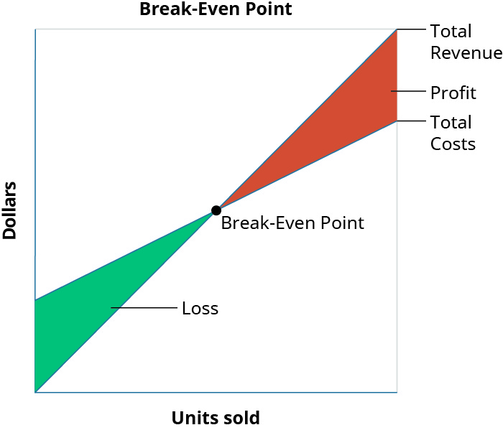
III: Calculating Cost-Informed Rates
What is Break-Even?
The point at which your business has no profit and no loss.
It requires the categorization of costs into Fixed and Variable (based on how they behave).
Is a 4-step Process
How do I calculate Break-Even?
Calculate Variable Cost & Fixed Cost Amounts
Calculate Variable Costs as a Percent of Sales
Calculate Contribution Margin
Divide Fixed Costs by Contribution Margin

Slide 22
III: Calculating Cost-Informed Rates
Calculate Variable Cost & Fixed Cost Amounts
a) Variable Costs=Materials; Food; & Direct Labor
b) Fixed Costs=The stuff not directly tied to revenue increases & decreases.
2. Calculate Variable Costs as a Percent of Sales
Find your previous year’s Total Revenue
i. Ideally, we’re using multiple years
Divide Variable Costs into Sales to get a percentage
i. This could be but is not always Gross Profit Margin depending on how you do your books.
3. Calculate Contribution Margin
100%-Variable Cost%=Contribution Margin%
4. Divide Fixed Costs by Contribution Margin
Divide Fixed Cost in $ into Contribution Margin %
Break Even (AKA: Cost-informed rate)
FC$/CM%=Break Even
It is okay for revenue to exceed break even.
This can also be done per unit, per child, per licensed spot, or per period.

Slide 23
III: Calculating - EXAMPLE
Calculate Variable Cost & Fixed Cost Amounts
a) Variable Costs = $412,770
b) Fixed Costs = $197,670
2. Calculate Variable Costs as a Percent of Sales
Total Revenue = $696,000
Variable Costs = $412,770
Variable Cost % = 59%
3. Calculate Contribution Margin
Total Revenue = 100%
Variable Cost% = -59%
Contribution Margin%= 41%
4. Divide Fixed Costs by Contribution Margin
Fixed Cost $ = $197,670
Contribution Margin%= 41%
Break Even = $485,748
If this program supported 63 kids, the per child rate would equal roughly $44 per child per day.
$696,000/250 days/63 kids=$44 per child per day.

Slide 24
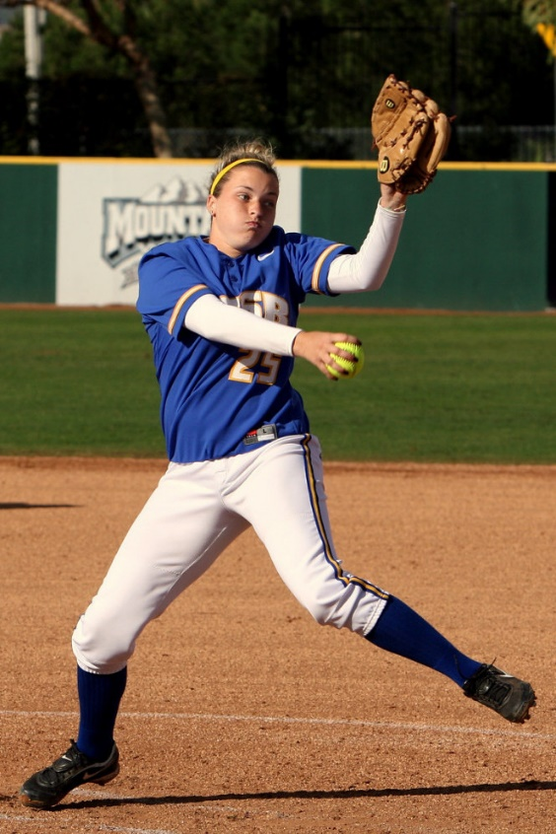
III: The Curve Balls
The Curve Balls
If your costs need to or are going up, the costs can be adjusted in a budget.
If you are not paying yourself (enough), the costs can be adjusted in a budget.
If your company isn’t profitable, profits can be projected in a budget.
This Photo by Unknown Author is licensed under CC BY-NC-ND
This Photo by Unknown Author is licensed under CC BY-NC-ND
This Photo by Unknown Author is licensed under CC BY-SA-NC

Slide 25
III: The Curve Balls
Adding Additional Costs – EXAMPLE
4. Divide Fixed Costs by Contribution Margin
Fixed Cost $ = $197,670
New Costs = $50,000
New Fixed Cost $ = $247,670
Contribution Margin%= 41%
Old Break Even = $485,748
New Break Even = $604,073
**Narrative: For every $50,000 in new costs, sales must increase $118,325.
This Photo by Unknown Author is licensed under CC BY-NC-ND
This Photo by Unknown Author is licensed under CC BY-NC-ND
This Photo by Unknown Author is licensed under CC BY-SA-NC

Slide 26
III: But Jason…What if…
What if my business is pre-venture or has less than 1 year of revenue?
We can use a margins-markup methodology.
Sometimes successive approximation applies.
This is an iterative process!

Slide 27
Summary
If you’re having troubles off-ramping from the Stabilization Grant and rates are a cause:
Three options:
Rate Adjustments
Revenue Diversification
Worst Case Scenarios

Slide 28
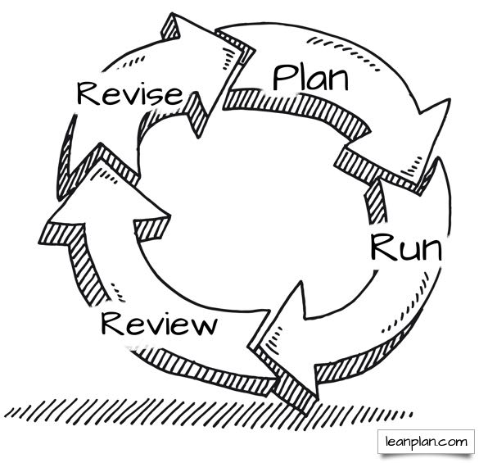
Summary
What we've learned:
Your business is unique
Accurate rate setting is art and science
Finance is FUN
MCCBC is here to help

Slide 29
Where Can I Learn More?
Training: Profit Mastery
https://sbdc.mt.gov/Services/Trainings-and-Workshops/Profit-Mastery
https://sbdc.mt.gov/Services/Trainings-and-Workshops/

Slide 30
Where Can I Learn More?
Technical Assistance: One-on-One Consultation
ChildCareBusinessConnect.com

Slide 31
Coming Up:
2/27/23: Precision Pricing for Family/Group
Register to attend through MT ECP Registry
3/6/23: Policies and Practices for Center Directors
Register to attend through MT ECP Registry
3/9/23: TTS: What is Risk Management?
Register to attend through MT ECP Registry
3/15/23: Board Governance for Programs
Register to attend through MT ECP Registry
3/23/23: TTS: What are the Types of Marketing?
Register to attend through MT ECP Registry
**More events and trainings to be announced soon!**
Past Recordings Available At:
On-Demand Webinars: ChildCareBusinessConnect.com

Slide 32
Connect with Business Connect!
Website: ChildCareBusinessConnect.com
Email: JasonN@ZerotoFive.org
Formally Request Assistance: https://mtsbdc.ecenterdirect.com/signup?centerid=21
Schedule a Meeting: https://jason-nit.youcanbook.me/
Newsletter: https://zerotofive.org/take-action/
Social:
This project is funded in whole or in part under a Contract with the Montana Department of Public Health and Human Services. The statements herein do not necessarily reflect the opinion of the Department.

Slide 33
How’d We Do?
https://www.surveymonkey.com/r/MV6KSD5

